Slide 1
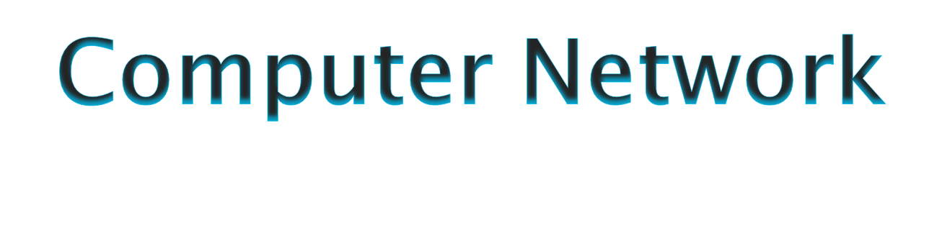



Slide 2

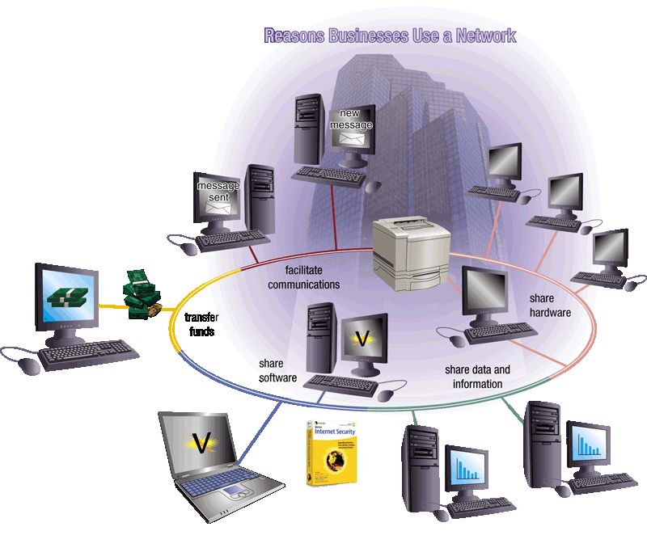
What is a Computer Network?
Collection of autonomous computers interconnected by a single technology is called computer network.
Two computers are set to be interconnected if they are able to exchange information.
Connection can be through a copper wire, fiber optics, microwaves, infrared or satellite.

Slide 3
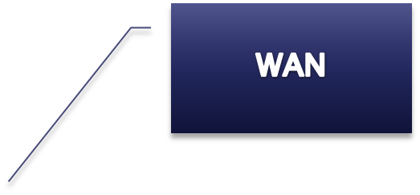
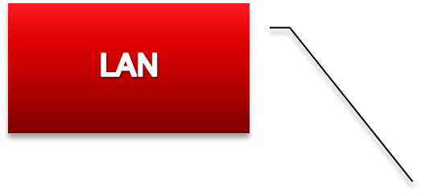

CATEGORIES OF NETWORKS

Slide 4

A Local Area Network (LAN) is a collection of networking equipment located geographically close together. E.g. Single room, campus etc.
Data transferred in High speed which ranges from 100 Mbps to gigabit for system development and have a low implementation cost.
Upper limit: 10 km ; Lower limit: 1 km
Twisted pair cable or Co-axial cable connects the plug in cards to form a network.
Designed to share resources between PCs and workstation such as hardware or data.

Slide 5

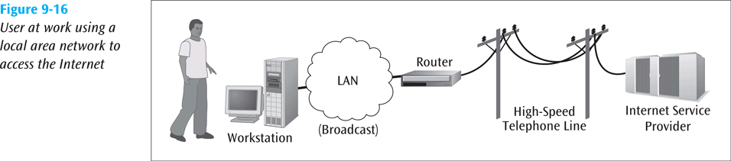
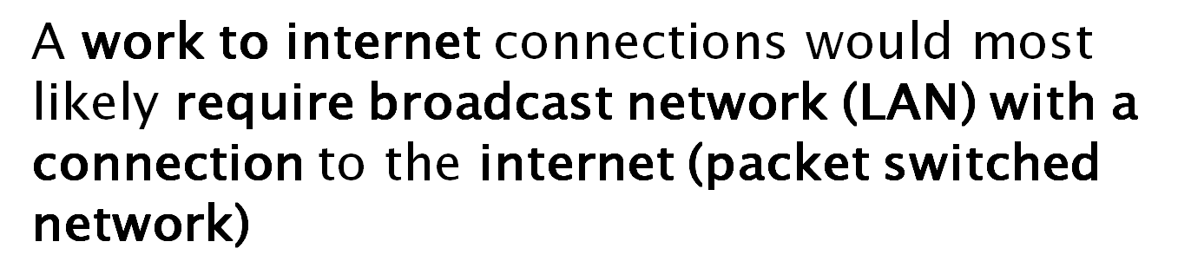

Slide 6


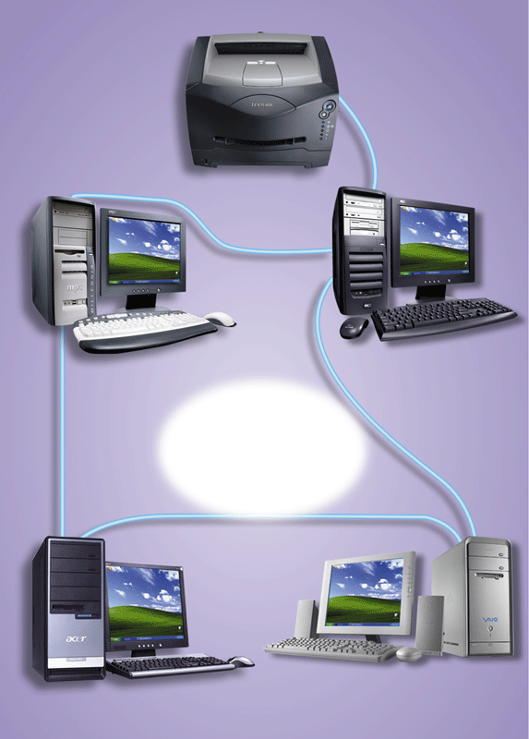
Cost reductions through sharing of information and databases, resources and network services.
Increased information exchange between different departments in an organization, or between individuals.
The trend to automate communication and manufacturing process.
• Special security measures are needed to stop users from using programs and data that they should not have access to;
• Networks are difficult to set up and need to be maintained by skilled technicians.
• If the file server develops a serious fault, all the users are affected, rather than just one user in the case of a stand-alone machine.

Slide 7
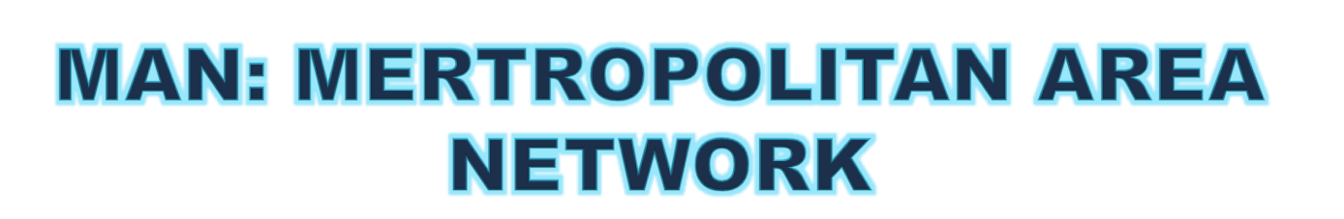
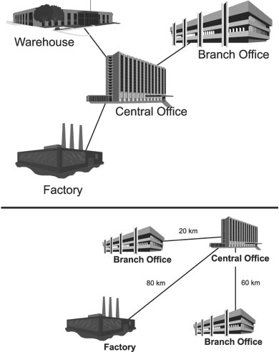

Slide 8

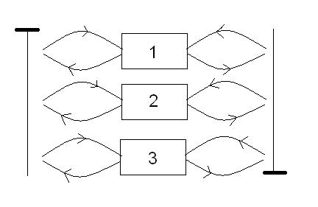
The metropolitan area network (MAN) is designed to extend over an entire city.
It may be a single network such as cable television network available in many cities.
A MAN uses distributed queue dual bus.
Range: Within 100 km (a city).
Bus A
MAN
Bus B

Slide 9


It provides a good back bone for a large network and provides greater access to WANs.
The dual bus used in MAN helps the transmission of data in both direction simultaneously.
A Man usually encompasses several blocks of a city or an entire city.
More cable required for a MAN connection from one place to another.
It is difficult to make the system secure from hackers and industrial espionage (spying) graphical regions.

Slide 10

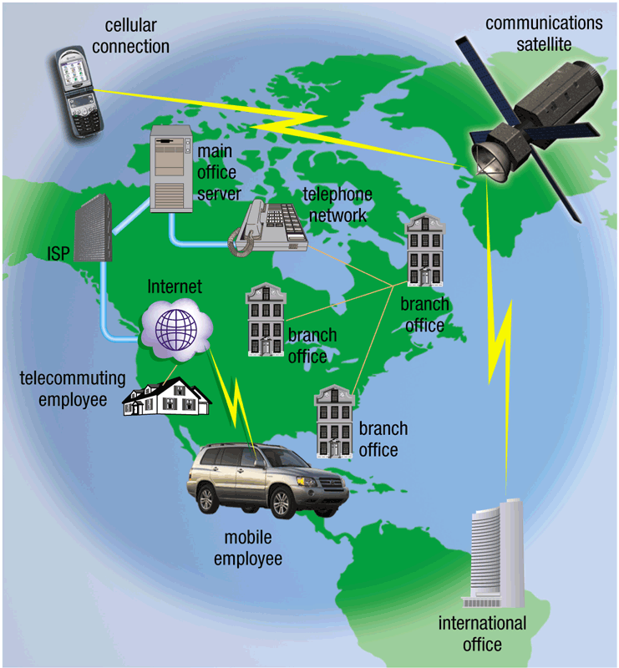
Network that provides long distance transmission of data, voice, image and video information over large geographical areas that may comprise a country, a continent.
Range: Beyond 100 km.

Slide 11


Covers a large geographical area so long distance businesses can connect on the one network.
Shares software and resources with connecting workstations.
Messages can be sent very quickly to anyone else on the network. These messages can have pictures, sounds, or data included with them (called attachments).
Expensive things (such as printers or phone lines to the internet) can be shared by all the computers on the network without having to buy a different peripheral for each computer.
Everyone on the network can use the same data. This avoids problems where some users may have older information than others.
Need a good firewall to restrict outsiders from entering and disrupting the network
Setting up a network can be an expensive, slow and complicated. The bigger the network the more expensive it is.
Once set up, maintaining a network is a full-time job which requires network supervisors and technicians to be employed.
Security is a real issue when many different people have the ability to use information from other computers. Protection against hackers and viruses adds more complexity and expense.

Slide 12
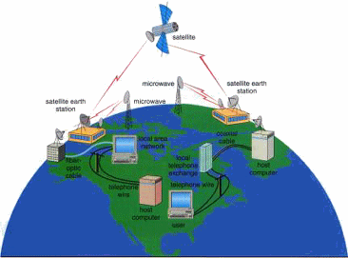

Slide 13
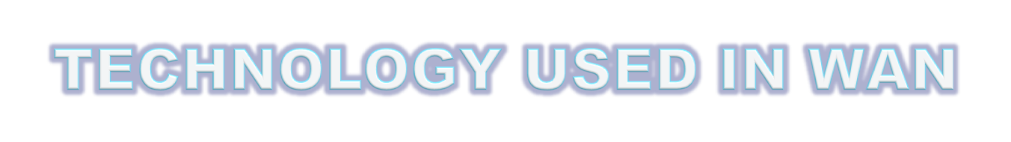







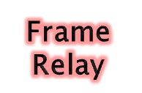
ISDN ( Integrated service digital network) 2 types
Basic rate interface
Primary rate interface
Frame relay
Switched multimegabit data service (SMDS)
Synchronous optical network (SONET)
High data link controlled (HDLC)
Synchronous Data Link Control (SDLC)

Slide 14

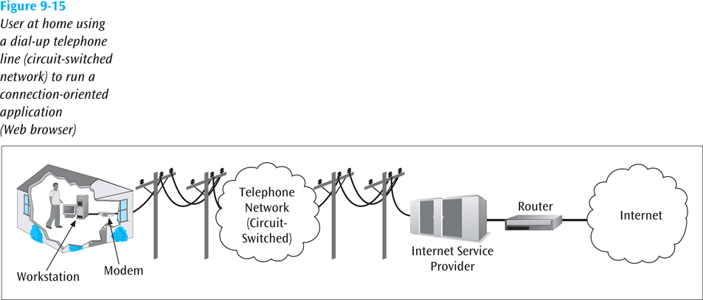

Slide 15
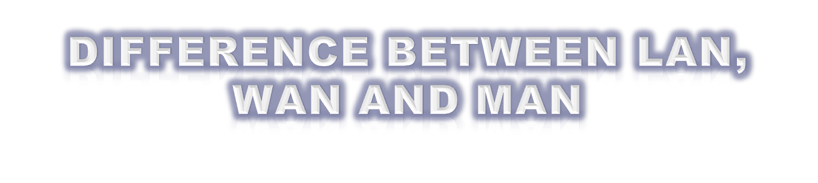
BASIS | LAN | MAN | WAN
Full Form | Local Area Network | Metropolitan Area Network | Wide Area Network
Range | A communication network linking a number of stations in same local area. Range is 1 to 10 km | This network shares the characteristics of packet broadcasting networks. Range is100 km | A communication network distinguished from a Local Area Network. Range is Beyond 100 km
Media Used | Uses guided media | Uses guided as well as unguided media | Uses unguided media
Speed | A high speed i.e. 100kbps to 100mbps | Optimized for a large geographical area than LAN. | Long distance communications, which may or may not be provided by public packet network.
Cost | cheaper | costly | expensive
Equipment needed | NIC, switch and hub | Modem and router | Microwave, radio, infra-red laser
protocols | Attached Resource computer network (ARCNET), Token ring | Frame relay and asynchronous transfer mode(ATM) | ATM, FDDI, SMDS

Slide 16


Tree Topology
Bus Topology
Ring Topology
LAN Topologies
Mesh Topology
Star Topology

Slide 17

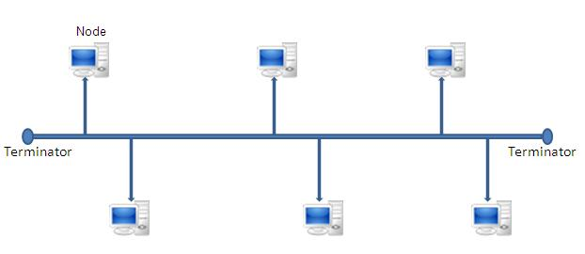
All the nodes (computers as well as servers) are connected to the single cable (called bus), by the help of interface connectors.
This central cable is the backbone of the network and is known as Bus. Every workstation communicates with the other device through this Bus.
A terminator is added at ends of the central cable, to prevent bouncing of signals.

Slide 18
Advantages (benefits) of Bus Topology
1) It is easy to set-up and extend bus network.
2) Cable length required for this topology is the least compared to other networks.
3) Bus topology costs very less.
4) Bus network is mostly used in small networks. Good for LAN.
Disadvantages (Drawbacks) of Bus Topology
1) There is a limit on central cable length and number of nodes that can be connected.
2) Dependency on central cable in this topology has its disadvantages. If the main cable (i.e. bus ) encounters some problem, whole network breaks down.
3) Maintenance costs can get higher with time.
4) Efficiency of Bus network reduces, as the number of devices connected to it increases.
5) It is not suitable for networks with heavy traffic.

Slide 19

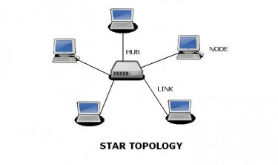
In Star topology, all the components of network are connected to the central device called “hub” which may be a hub, a router or a switch.
Unlike Bus topology , where nodes were connected to central cable, here all the workstations are connected to central device with a point-to-point connection. So it can be said that every computer is indirectly connected to every other node by the help of “hub”.

Slide 20
All the data on the star topology passes through the central device before reaching the intended destination.
Hub acts as a junction to connect different nodes present in Star Network, and at the same time it manages and controls whole of the network.
Central device can also communicate with other hubs of different network. Unshielded Twisted Pair (UTP) Ethernet cable is used to connect workstations to central node.

Slide 21
Advantages of Star Topology
1) As compared to Bus topology it gives far much better performance, signals don’t necessarily get transmitted to all the workstations. A sent signal reaches the intended destination after passing through no more than 3-4 devices and 2-3 links. Performance of the network is dependent on the capacity of central hub.
2) Easy to connect new nodes or devices. New nodes can be added easily without affecting rest of the network. Similarly components can also be removed easily.
3) Centralized management. It helps in monitoring the network.
4) Failure of one node or link doesn’t affect the rest of network. At the same time its easy to detect the failure and troubleshoot it.
Disadvantages of Star Topology
1) Too much dependency on central device has its own drawbacks. If it fails whole network goes down.
2) The use of hub, a router or a switch as central device increases the overall cost of the network.
3) Performance and as well number of nodes which can be added in such topology is depended on capacity of central device.

Slide 22

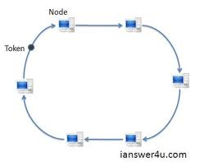
In Ring Topology, all the nodes are connected to each-other in such a way that they make a closed loop.
Each workstation is connected to two other components on either side, and it communicates with these two adjacent neighbors. Data travels around the network, in one direction. Sending and receiving of data takes place by the help of TOKEN

Slide 23
Token Passing : Token contains a piece of information which along with data is sent by the source computer. This token then passes to next node, which checks if the signal is intended to it.
If yes, it receives it and passes the empty to into the network, otherwise passes token along with the data to next node. This process continues until the signal reaches its intended destination.
The nodes with token are the ones only allowed to send data. Other nodes have to wait for an empty token to reach them. This network is usually found in offices, schools and small buildings

Slide 24
Advantages of Ring Topology
1) Each node gets to send the data when it receives an empty token. This helps to reduces chances of collision. Also in ring topology all the traffic flows in only one direction at very high speed.
2) Even when the load on the network increases, its performance is better than that of bus topology .
3) There is no need for network server to control the connectivity between workstations.
4) Additional components do not affect the performance of network.
5) Each computer has equal access to resources.
Disadvantages of Ring Topology
1) Each packet of data must pass through all the computers between source and destination. This makes it slower than Star topology.
2) If one workstation or port goes down, the entire network gets affected.
3) Network is highly dependent on the wire which connects different components.
4) MAU’s and network cards are expensive as compared to Ethernet cards and hubs.

Slide 25

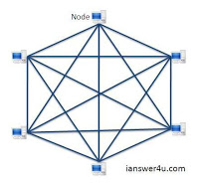
In a mesh topology, each of the network node, computer and other devices, are interconnected with one another.
Every node not only sends its own signals but also relays data from other nodes.
In fact a true mesh topology is the one where every node is connected to every other node in the network. This type of topology is very expensive thus it is not mostly used in computer networks.
It is commonly used in wireless networks. Flooding or routing technique is used in mesh topology.

Slide 26
Advantages of Mesh topology
1) Data can be transmitted from different devices simultaneously. This topology can withstand high traffic.
2) Even if one of the components fails there is always an alternative present. So data transfer doesn’t get affected.
3) Expansion and modification in topology can be done without disrupting other nodes.
Disadvantages of Mesh topology
1) There are high chances of redundancy in many of the network connections.
2) Overall cost of this network is way too high as compared to other topologies.
3) Set-up and maintenance of this topology is very difficult.

Slide 27

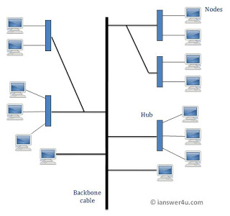
Tree Topology integrates the characteristics of Star and Bus topology.
In Tree Topology, the number of Star networks are connected using Bus.
This main cable seems like a main stem of a tree, and other star networks as the branches.
It is also called Expanded Star Topology.

Slide 28
Advantages of Tree Topology
1. It is an extension of Star and bus Topologies, so in networks where these topologies can't be implemented individually for reasons related to scalability, tree topology is the best alternative.
2. Expansion of Network is possible and easy.
3. Here, we divide the whole network into segments (star networks), which can be easily managed and maintained.
4. Error detection and correction is easy.
5. Each segment is provided with dedicated point-to-point wiring to the central hub.
6. If one segment is damaged, other segments are not affected.
Disadvantages of Tree Topology
1. Because of its basic structure, tree topology, relies heavily on the main bus cable, if it breaks whole network is crippled.
2. As more and more nodes and segments are added, the maintenance becomes difficult.
3. Scalability of the network depends on the type of cable used.

